Slide 1


R. GLENN
HUBBARD
ANTHONY PATRICK
O’BRIEN
FIFTH EDITION
© 2015 Pearson Education, Inc.

Slide 2
Firms, the Stock Market, and Corporate Governance

Slide 3
Why firm structure, finance, and governance?
In this chapter we will examine how firms are run:
How they are organized,
How they obtain financing,
How they convey information to the public, and
Whether they act in the best interest of their owners.
Each of these items affect how firms behave, and what their overall impact on the economy will be.

Slide 4
Types of Firms
8.1
Categorize the major types of firms in the United States.

Slide 5
The types of firms
Firms are legally categorized in the U.S. as one of the following:
Sole Proprietorships:
Firms owned by a single individual and not organized as a corporation.
Partnerships:
Firms owned jointly by two or more persons and not organized as a corporation.
Corporations:
A legal form of business that provides owners with protection from losing more than their investment should the business fail.

Slide 6
Who is liable? Limited and unlimited liability
In sole proprietorships and partnerships, no legal distinction is made between the assets of the firm and the assets of its owner(s).
Asset: Anything of value owned by a person or a firm.
This is not the case for corporations. The owners of corporations have limited liability, a legal provision shielding owners of the corporation from losing more than they have invested in the firm.
Limited liability makes raising funds easier for a firm; it also makes investing in firms easier for individuals.

Slide 7
Differences among business organizations
 | Sole Proprietorship | Partnership | Corporation
Advantages | • Control by owner • No layers of management | • Ability to share work • Ability to share risks | Limited personal liability • Greater ability to raise funds
Disadvantages | • Unlimited personal liability | • Unlimited personal liability | • Costly to organize
 | • Limited ability to raise funds | • Limited ability to raise funds | • Possible double taxation of income
Table 8.1
Differences among business organizations
There is not a unique best business structure.
Corporations benefit from limited liability, but are expensive to organize.
Also, their profits may be taxed twice: once as corporate profits, and again when the profits are disbursed to investors.

Slide 8



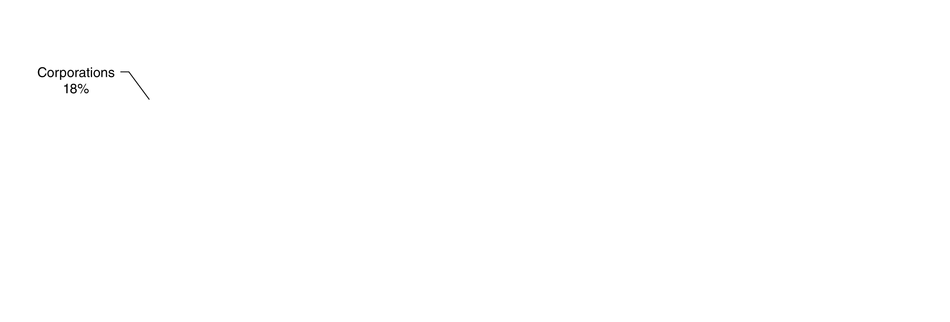

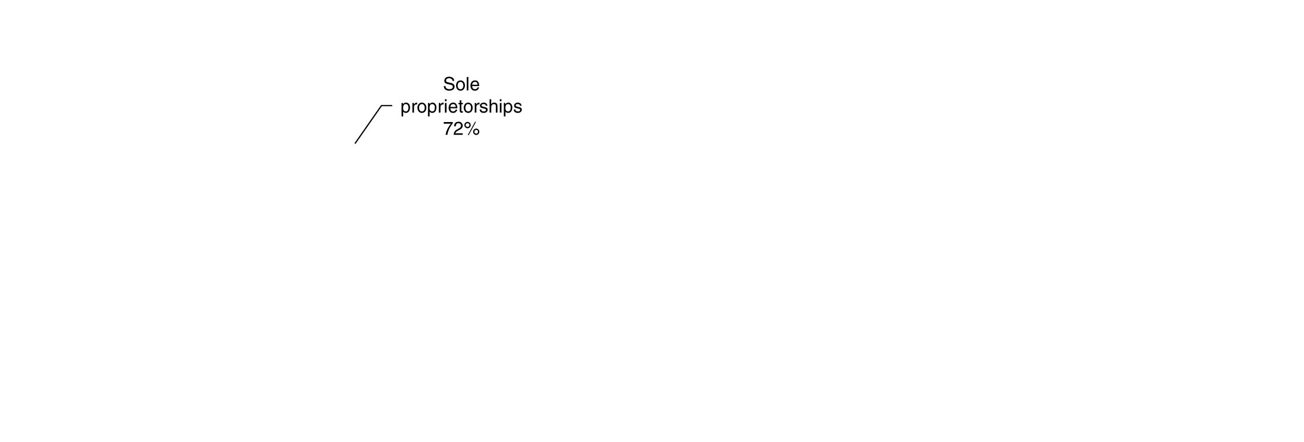








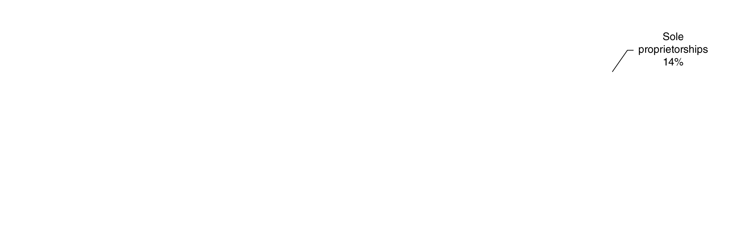

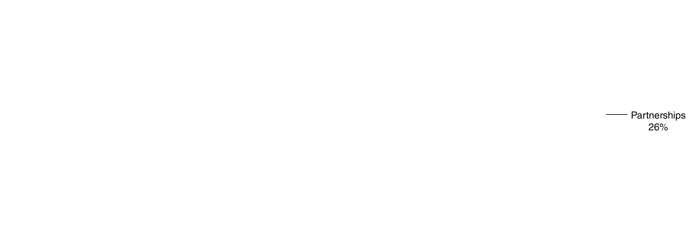

Proportions of business organizations
(a) Number of firms (b) Revenue (c) Profits
Figure 8.1
Business organizations: sole proprietorships, partnerships, and corporations
Nearly ¾ of firms are sole proprietorships, and just one in six is a corporation.
But since larger firms tend to be corporations, most economic activity takes place through them.
Notes:
partnerships, and corporations. Panel (a) shows that only 18 percent of
all firms are corporations. Yet, as panels (b) and (c) show, corporations
account for a majority of the revenue and profits earned by all
firms.
Source: Internal Revenue Service, Statistics on Income.

Slide 9
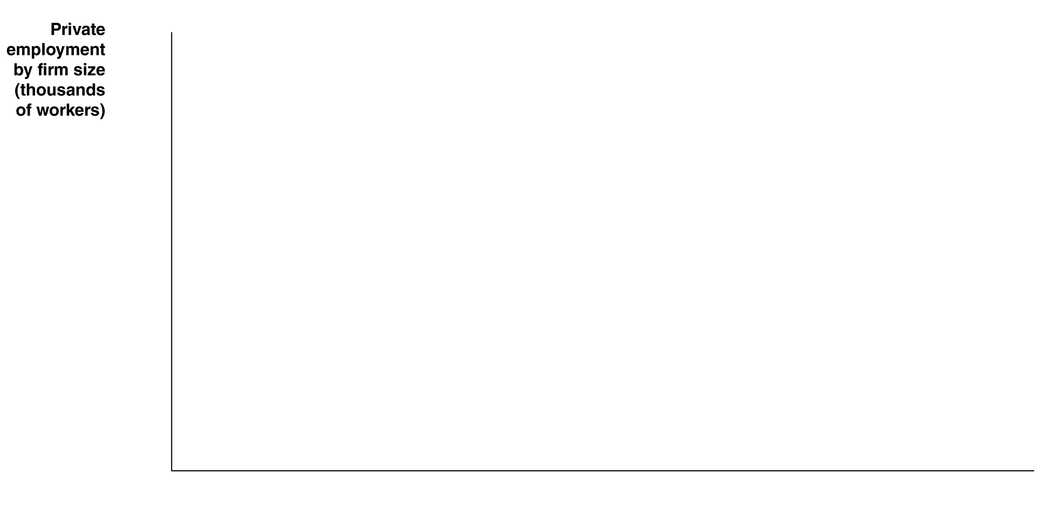

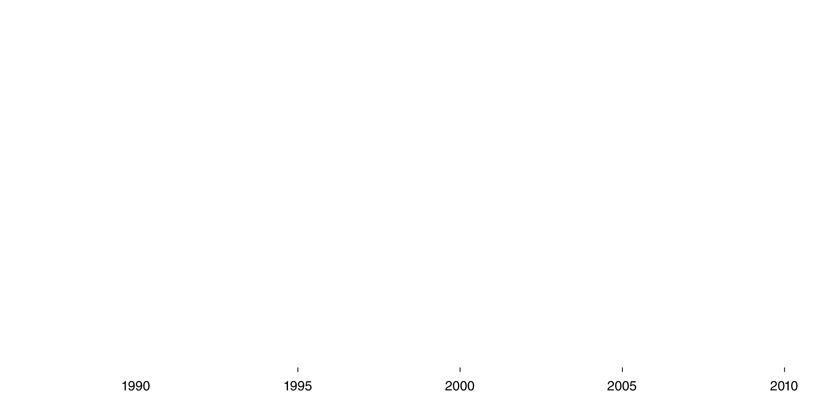




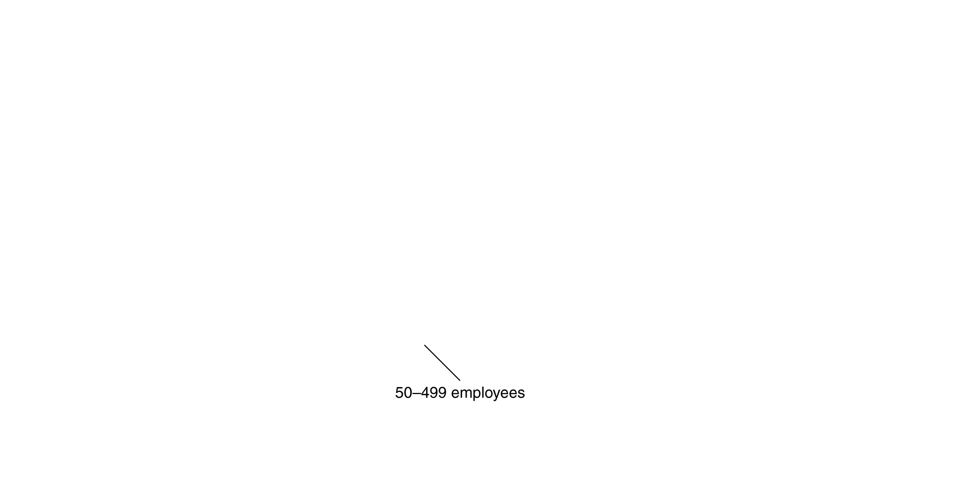

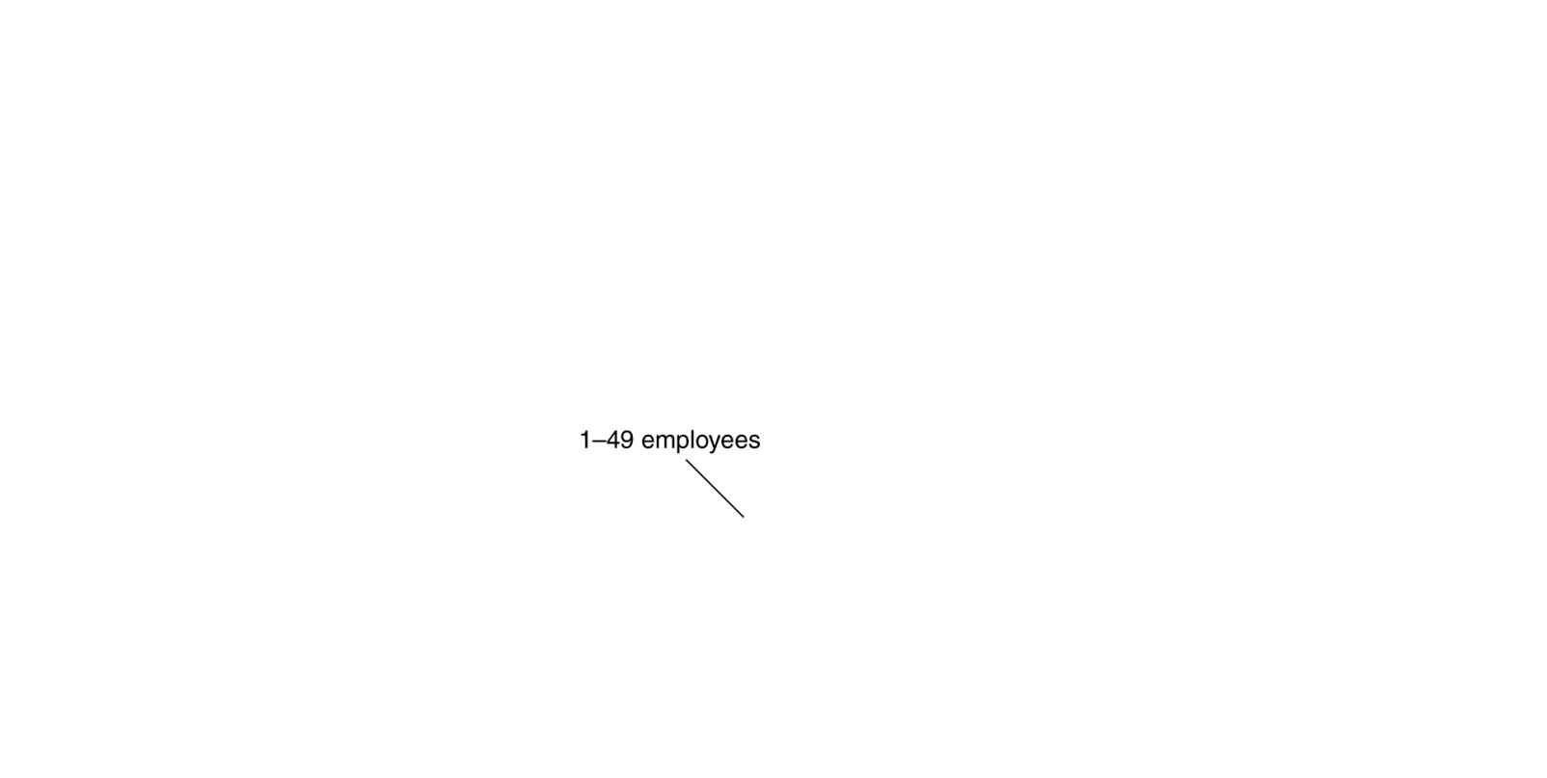

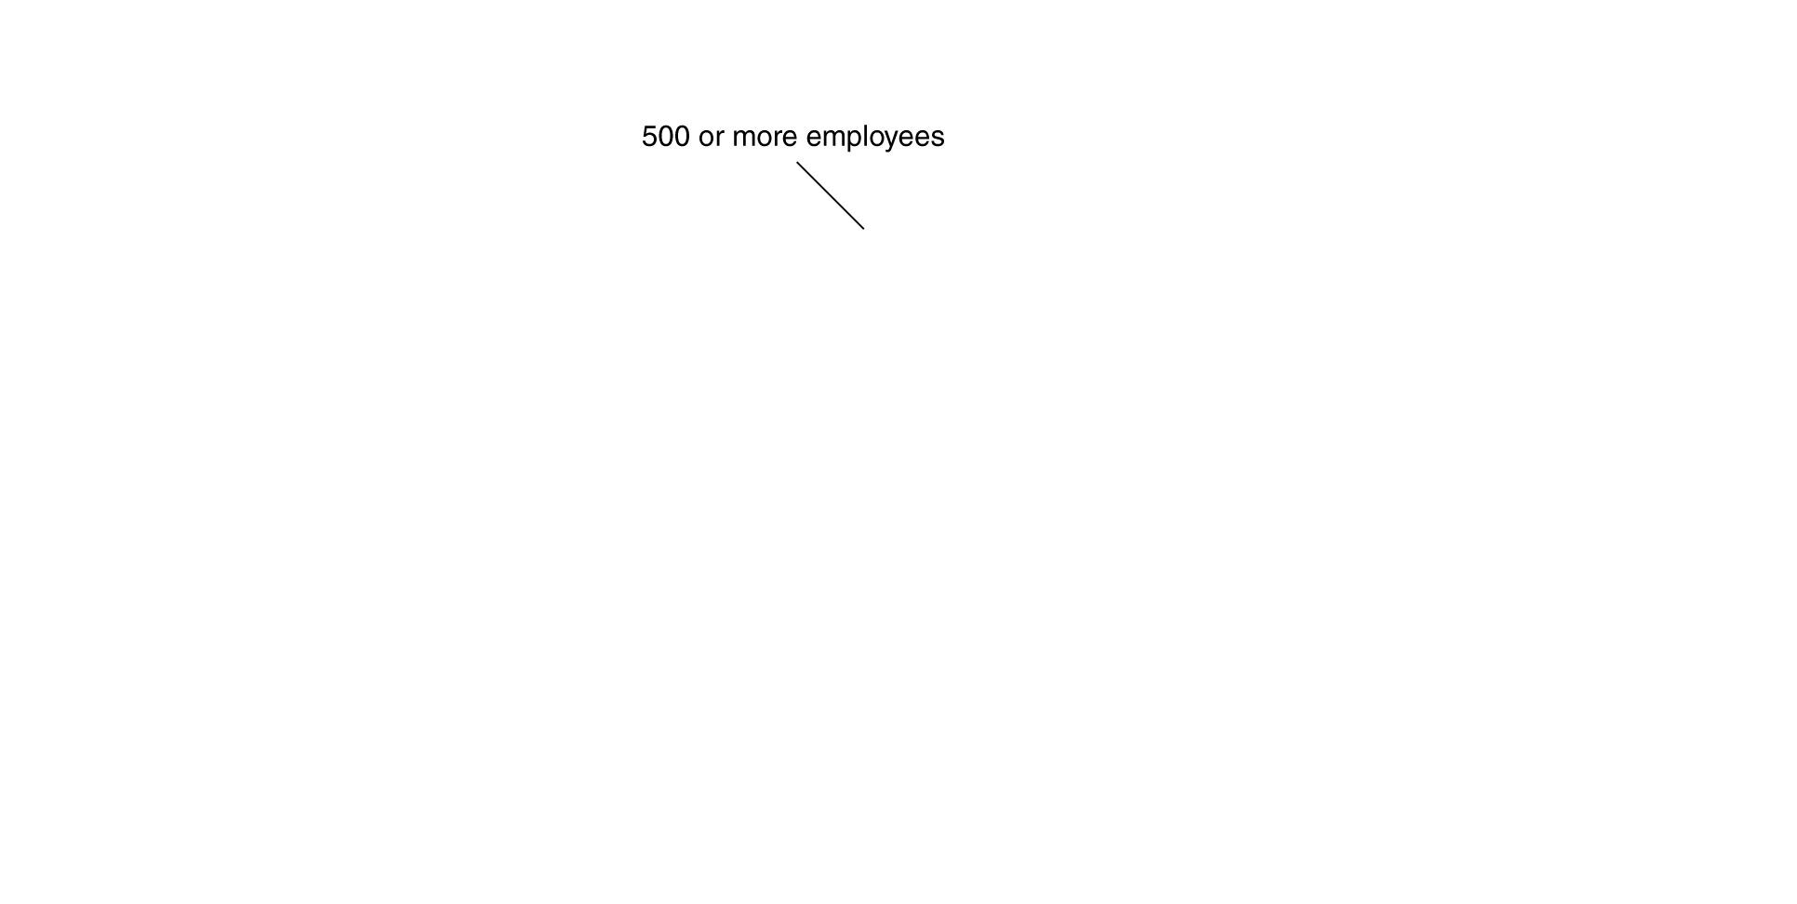
The importance of small business
Most economists argue that small firms are vital
to the health
of the economy.
In a typical year, new small firms create 3.3 million jobs—40% of all new jobs created.
Similarly, while large firms may be good at improving existing products, small firms are often better at creating new and innovative products and services.
Also, small firms are less likely to lay off workers during a recession (red bars on the graph).

Slide 10
The Structure of Corporations and the Principal–Agent Problem
8.2
Describe the typical management structure of corporations and understand the concepts of separation of ownership from control and the principal–agent problem.

Slide 11
Corporate structure and corporate governance
In sole proprietorships and partnerships, the owners of the firm are typically involved in day-to-day decisions at the firm.
This is not the case for larger corporations; they usually have separation of ownership from control.
Separation of ownership from control: a situation in a corporation in which the top management, rather than the shareholders, controls day-to-day operations.
Owners designate a board of directors, who appoint a chief executive officer (CEO) to oversee day-to-day operations, perhaps along with other members of top management.

Slide 12
Corporations and the principal-agent problem
The way in which a corporation is structured and the effect that structure has on the corporation’s behavior is known as corporate governance.
While the board of directors and top management are, in theory, representing the interests of the firm owners, they may sometimes pursue their own agendas.
Example: Managers may procure for themselves a very high salary, or perks such as corporate private jets.
The conflict between the interests of shareholders and the interests of top management is a principal-agent problem.
Principal-agent problem: A problem caused by an agent pursuing his own interests rather than the interests of the principal who hired him.

Slide 13
Can the principal-agent problem be resolved?
The principal-agent problem derives from economic incentives being improperly aligned.
A remedy for the problem must be based on aligning the interests.
This is why many top managers are paid a large part of the salary in stock or stock options: their salary becomes tied to the performance of the firm.
However since the CEO owns only a fraction of the firm, incentives can never be 100% aligned.

Slide 14
How Firms Raise Funds
8.3
Explain how firms raise the funds they need to operate and expand.

Slide 15
Raising funds as a small business owner
Small business owners have three principal methods of raising funds:
Retained earnings
Profits reinvested in the firm, instead of paid to firm owners.
Recruit additional owners
Such an arrangement would increase the firm’s financial capital.
Borrow
From financial institutions, or from friends or family.

Slide 16
Raising funds as your firm grows: indirect finance
As firms get larger, the need to obtain external funds tends to grow.
The economy’s financial system facilitates the transfer of funds from savers to borrowers.
Firms can borrow money from banks. As such, the banks are acting as financial intermediaries, permitting indirect finance of the firm by their savers.
Indirect finance: A flow of funds from savers to borrowers through financial intermediaries such as banks. Intermediaries raise funds from savers to lend to firms (and other borrowers).

Slide 17
Raising funds as your firm grows: direct finance
Alternatively, firms can appeal directly to potential investors for funds. This is direct finance: the flow of funds from savers to firms through financial markets, such as the New York Stock Exchange.
Direct finance generally takes the form of one of two financial securities:
Bonds
A financial security that represents a promise to repay a fixed amount of funds.
Stocks
A financial security that represents partial ownership of a firm.

Slide 18
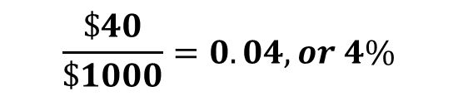
Bonds
A bond is financial security that is essentially a loan.
A firm sells a bond for its face value, say $1000, promising to repay this principal at the end of some term, say 30 years.
The bond will also include a series of coupon payments, intermediate payments that will be made to the bond-holder; say, $40 every year.
The interest rate, or cost of borrowing, can be expressed as the ratio of the coupon payment to the principal; in this case,
$$\frac{\$40}{\$1000}=0.04, or 4\%$$
The higher the default risk, the higher the coupon payment (hence the interest rate) the firm will have to offer.

Slide 19
Stocks
Unlike bonds, stocks are financial securities that represent partial ownership of the firm.
A corporation that sells a stock acts similarly to a partnership taking on a new partner; though the new shareholder typically owns a tiny fraction of the firm.
When the corporation makes profits, these are either reinvested in the firm—causing a capital gain, or increase in value of the stock—or paid out to the firm’s shareholders as dividends.
By law, corporations must repay bondholders before shareholders. This helps to ensure that bonds are substantially less risky financial securities to hold than stocks.

Slide 20
Conflicts of interest in credit-rating agencies
The three main credit-rating agencies (Moody’s, Standard and Poor’s, and Fitch) assign ratings to bonds.
This service helps investors to determine which bonds are safe and which at risk of default (non-payment).
However payment for the ratings comes from the firms and governments issuing the bonds, creating the potential for a conflict of interest.
Such a conflict of interest may explain why the mortgage-backed bonds issued in the mid-2000s continued to score the highest ratings, even as housing prices began to decline, raising the risk of mortgage default.

Slide 21
Stock and bond markets provide capital—and information
After firms sell their stocks and/or bonds, these financial securities can be traded in stock and bond markets.
The existence of these resale markets is beneficial for society, since without them, individuals could not invest in firms without tying up their money for a long time.
The price at which a stock trades indicates the degree of confidence in the firm’s ability to make future profits, since these profits are what is used to generate a return for investors.
The price at which a bond trades is determined by its coupon payment, relative to other coupon payments available. But it also reflects the confidence of investors in the firm’s ability to make those payments.

Slide 22
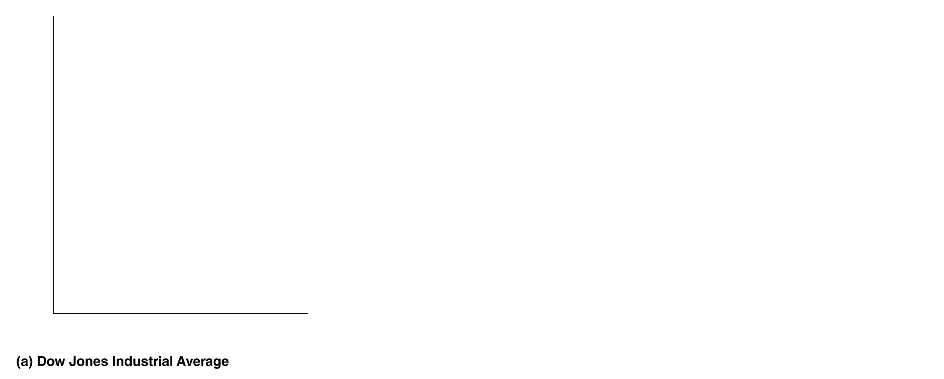



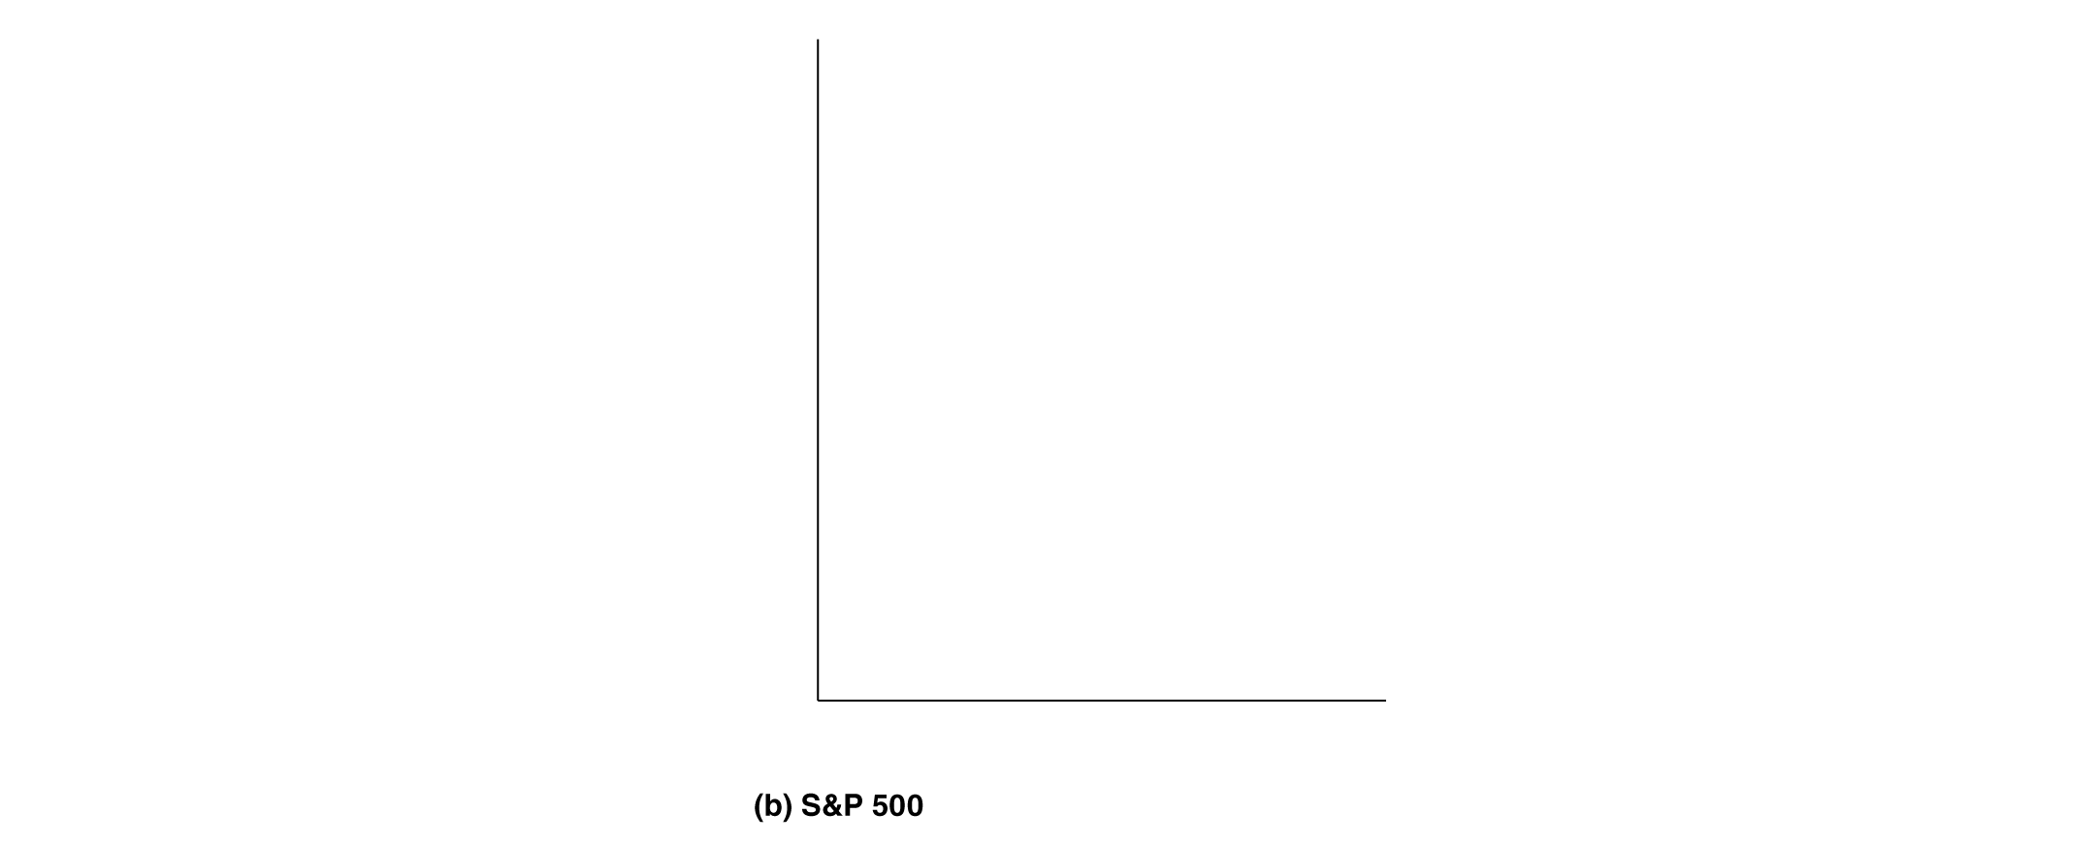



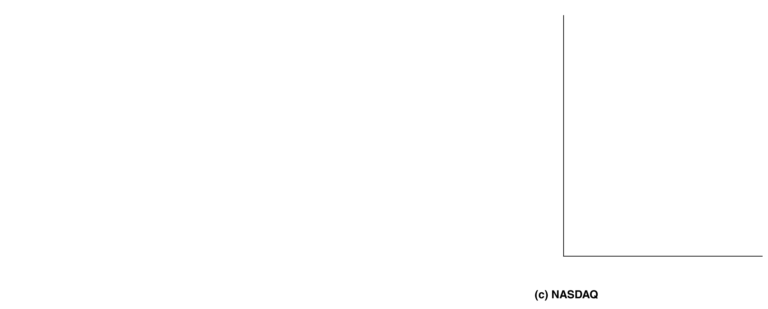



Why do stock prices fluctuate so much?
Since a stock represents a claim to a share of future profits of a firm, changes in expectations about those profits get reflected in the stock’s price.
When the overall economy performs well, a “rising tide lifts all boats”, and the price of a stock rises, reflecting investor confidence. The opposite happens in a recession, of course.
Figure 8.2
Movements in stock market indexes, January 1996-June 2013
Notes:
The performance of the U.S. stock market is often measured by market indexes,
which are averages of stock prices. The three most important indexes are the
Dow Jones Industrial Average, the S&P 500, and the NASDAQ. During the period
from 1996 to 2013, the three indexes followed similar patterns, rising when the
U.S. economy was expanding and falling when the economy was in recession.
Note that in all three panels the vertical axis does not start at zero.

Slide 23
Why do stock prices fluctuate so much? Cont.
The values shown are stock market index numbers, created as weighted averages of the underlying stock prices.
By convention, the index is set to a value of 100 in some base year; but since the year and initial value are arbitrary, it is changes in the index number that are relevant for determining market performance.
Figure 8.2
Movements in stock market indexes, January 1996-June 2013

Slide 24
Using Financial Statements to Evaluate a Corporation
8.4
Understand the information provided in corporations’ financial statements.

Slide 25
Which firm(s) should you invest in?
Investment decisions are relatively complicated, but can be made more intelligently with information from a firm’s financial statements.
In the U.S., publicly-owned firms are required to release regular financial statements prepared using standard accounting methods known as generally accepted accounting principles.
Ideally, such statements would present information in an unbiased manner, reducing information costs for investors.
Firms specializing in information sell their services in verifying and investigating these reports.

Slide 26
What’s in a firm’s financial statements?
The two principal items in a firm’s financial statements are:
Income Statements:
A summary of the firm’s revenues, costs, and profit over a period of time—typically a 12-month fiscal year, which does not necessarily coincide with the calendar year.
Balance Sheets:
A financial statement that sums up a firm’s financial position on a particular day, usually the end of a quarter or year.
This summarizes the liabilities (anything owed by a person or firm) and assets of the firm.
A firm’s net worth is calculated as the amount of its assets minus the amount of its liabilities.

Slide 27
Accounting profit
A firm’s income statement reveals the profit that the firm makes.
Profit on the income statement is referred to as net income, and is calculated as revenue minus operating expenses and taxes paid.
Economists refer to this as accounting profit, and call the listed expenses explicit costs, costs that involve actually spending money.
$$Accounting Profit=Revenue − Explicit Costs$$

Slide 28
Economic profit
Economists differ from accountants when calculating profit, because economists and accountants have different intents:
Accountants present financial information in order to allow people to make judgments on investments.
Economists are interested in decision-making; whether investing in the firm is wise, and whether the firm should continue to operate.
So it is important for economists to consider the whole opportunity cost of the firm’s activities, including both explicit and implicit costs: opportunity costs that do not require an outlay of money; for example, a firm owner’s time, or the next-best use for their invested funds.
Opportunity cost: the highest valued alternative that must be given up to engage in some activity

Slide 29
Corporate Governance Policy and the Financial Crisis of 2007–2009
8.5
Discuss the role that corporate governance problems may have played in the financial crisis of 2007–2009.

Slide 30
The importance of accurate financial statements
Accurate and truthful financial statements are critical for investors to make investment decisions. Investments help guide resource allocation within the economy.
Firms disclose financial statements in periodic filings to the federal government, and in annual reports to shareholders.
If these financial statements are inaccurate, the whole economy suffers, as resources are allocated to less productive activities.
This reduces economic growth directly, and reduces investor confidence which further erodes growth.

Slide 31
The accounting scandals of the early 2000s
In the early 2000s, top managers at Enron and WorldCom were shown to have falsified their firms’ financial statements.
Some of these managers served jail time, but the damage done to many investors was severe.
The government creates regulations to try to minimize the chance of such deception. The accounting scandals prompted the Sarbanes-Oxley Act (2002), requiring that CEOs personally certify financial statements, and requiring disclosure of conflicts of interest from auditors, the accountants charged with checking the accuracy of financial statements.

Slide 32
The financial crisis of 2007-2009
Beginning in 2007 and lasting into 2009, the U.S. economy suffered the worst financial crisis since the Great Depression.
At its heart were financial instruments based on home mortgage loans: mortgage-backed securities.
These instruments appeared to be much like bonds, and though many of the underlying mortgages were risky (made to “subprime” borrowers), the securities were incorrectly perceived to be low-risk.
When prices fell in many housing markets, the underlying mortgages went into default, and the value of the securities plunged.

Slide 33
The financial crisis of 2007-2009—continued
The mortgage-backed securities had become popular with many investors, including large investment banks and insurance companies.
These companies suffered heavy losses, and several were able to remain in business only through federal government aid.
The crisis prompted the Wall Street Reform and Consumer Protection Act (2010).
Also known as the Dodd-Frank Act.
Created Consumer Financial Protection Bureau, intended to protect consumers in their borrowing and investing activities.
Established Financial Stability Oversight Council, intended to identify and act on risks in the financial system.
Overall effect on likelihood of future financial crises: unknown.

Slide 34
Principal-agent problems and the financial crisis
Investment banks (financial institutions that, among other things, aided corporations in stock- and bond-issuance) were traditionally organized as partnerships.
By 2000, they had all converted to corporations. The managers now had short-term perspectives, and less incentive to avoid risk:
“No investment bank owned by its employees would have … bought and held $50 billion in [exotic mortgage-backed securities]. … or even allow [these securities] to be sold to its customers. The hoped-for short-term gain would not have justified the long-term hit.”
- Michael Lewis, former Wall Street bond salesman

Slide 35
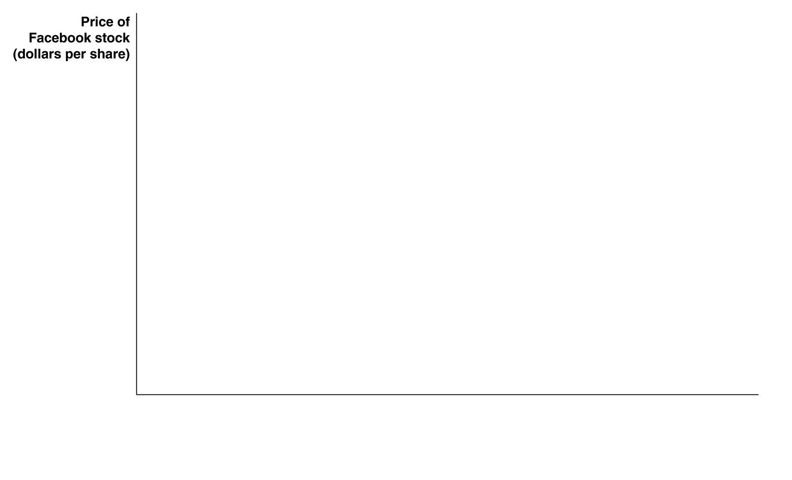


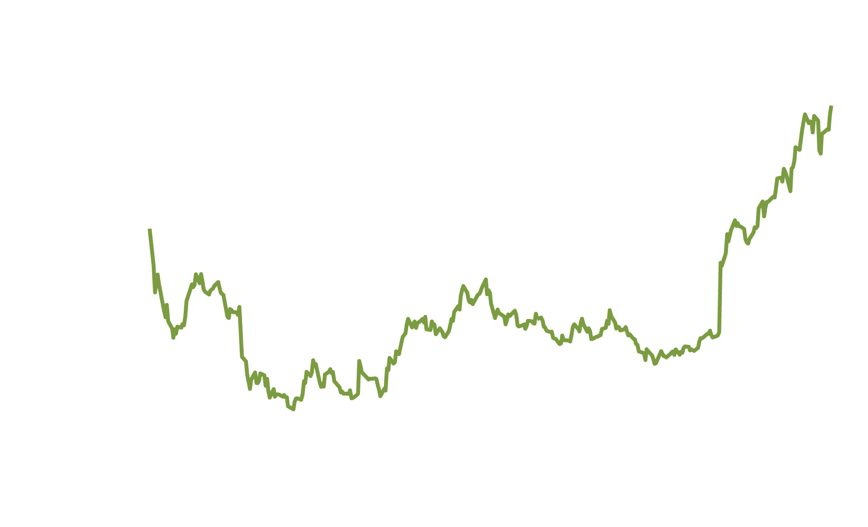
The ups and downs of investing in Facebook
Facebook’s Initial Public Offering (IPO) priced shares of Facebook at $38 apiece. A month after the IPO, the price had fallen by 40%.
However by September 2013, the stock price was over $47. What explains the swings in Facebook’s stock price?

Slide 36
Facebook’s ups and downs—continued
Stock prices are difficult to predict—they represent beliefs about future profitability. News can have a strong impact on prices.
For Facebook, the drops in price had to do with difficulty selling advertising; and the sharp rise in July 2013 came after unexpectedly high ad sales on mobile devices.

Slide 37
Common misconceptions to avoid
Profit in economics tends to refer to economic profit, which takes into account all opportunity costs. This can be substantially different to accounting profit, which only considers explicit costs.
When a firm makes shares available, it receives the money from the sale. Subsequent trades of those shares do not result in any profit or loss for the firm, however.
The principal-agent problem can occur on various levels: between a firm’s owners and managers, and between managers and workers.

Slide 38
Appendix: Tools to Analyze Firms’ Financial Information
Understand the concept of present value and the information contained on a firm’s income statement and balance sheet.

Slide 39
Present value
When people lend money, they expect to receive back more than they lend.
$1000 today is worth more than $1000 a year from now; and that in turn is worth less than $1000 two years from now.
How much are funds in the future worth to you? Economists refer to this amount as the present value of those funds: the value in today’s dollars of funds to be paid or received in the future.
The general formula is:
where Future value_{n} represents funds that will be received in n years, and i is the rate of interest.

Slide 40
Present value of a series of payments
When calculating the present value of a series of payments, we add the present values of each individual payment.
For example, suppose you will receive $50,000 immediately, and $50,000 each year for four additional years. The present value of this series of payments, assuming a 10% interest rate, is:

Slide 41
What interest rate should we use?
The interest rate to use depends on how each person values future payments compared with present payments:
If you are very impatient, a high interest rate describes your time preferences for funds.
If you are very patient, a low interest rate is appropriate.
As people become able to borrow and save for themselves, their personal interest rates become related to the rates at which they can borrow or save.

Slide 42
Using present value to calculate bond prices
Suppose that in 2014, you are considering buying a $1000 bond with $80 coupon payments (in 2015 and 2016) and a 2016 maturity date.
So you will receive $80 in 2015 and $1080 in 2016.
If your personal interest rate is 10%, you value this bond at:
However if your personal interest rate is 5%, you value this bond at:

Slide 43
Using present value to calculate stock prices
Valuing a stock is a little trickier, since there is no end-date on a stock—you own a share of the firm forever.
The value of a stock derives from the expected dividend payments of the stock.
Suppose you expect a stock to pay a $5 dividend this year, and the dividend will grow at a rate of 5% per year. There is a nice shortcut to finding the value of the stock:
(assuming you have a 10% personal interest rate).

Slide 44
Going deeper into financial statements
Using the income statements and balance sheets of a firm, we can learn a lot about the firm’s profitability and financial positions.
Recall that an income statement gives a record of the firm’s revenues and costs over a period of time, while a balance sheet gives a “snapshot” of the firm’s financial position at a particular point in time.
On the next slides, we will see Facebook’s income statement from 2012, and its balance sheet as of December 31, 2012.

Slide 45
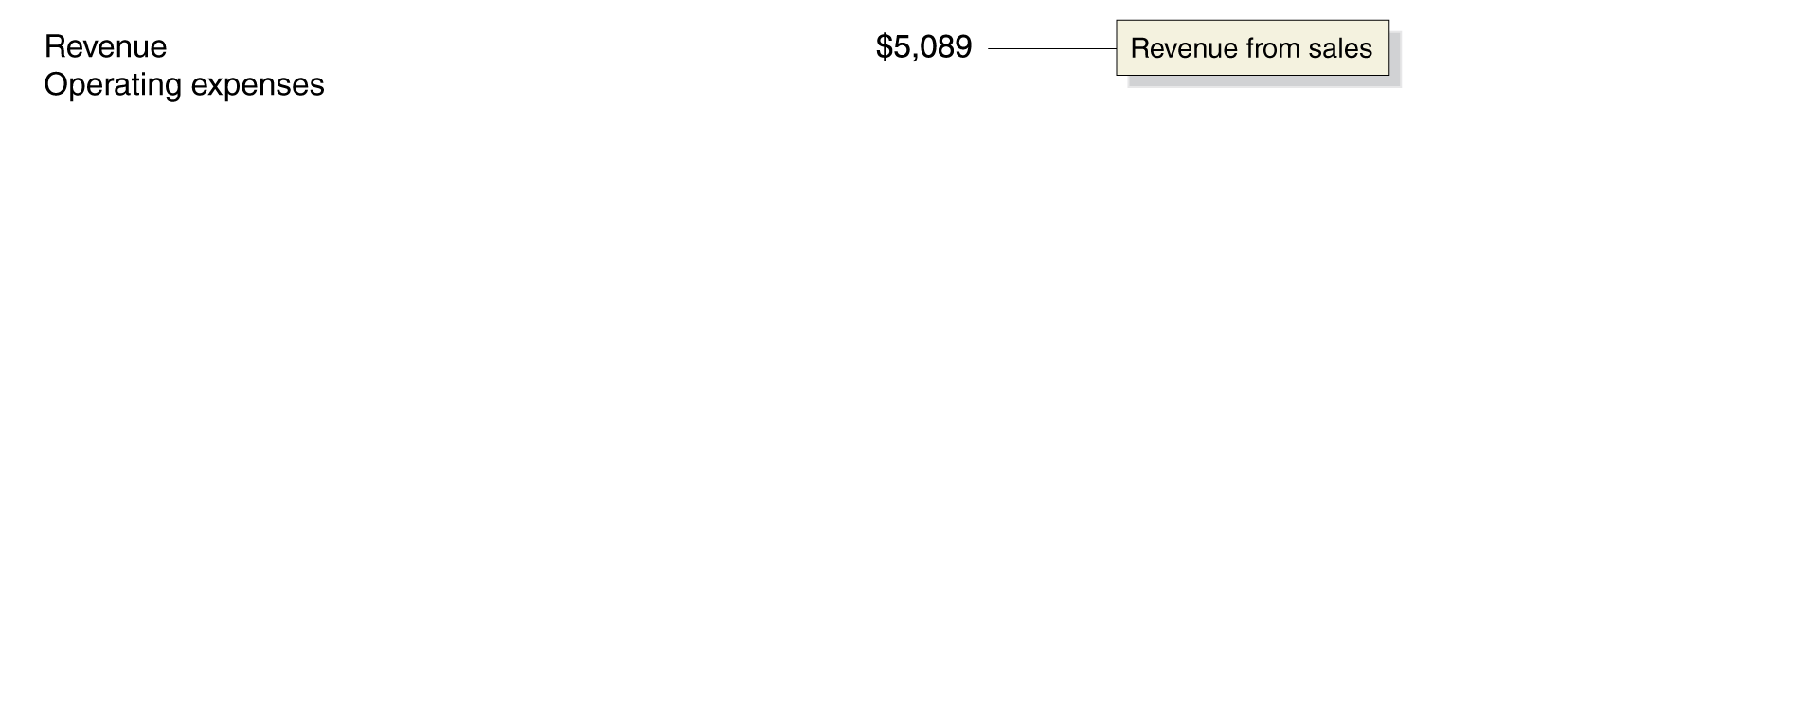
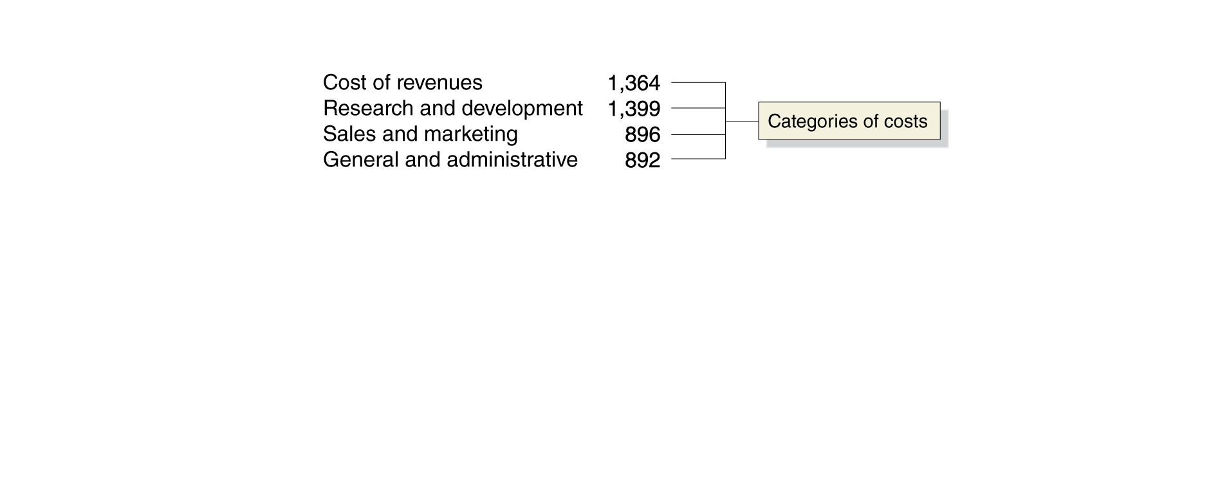
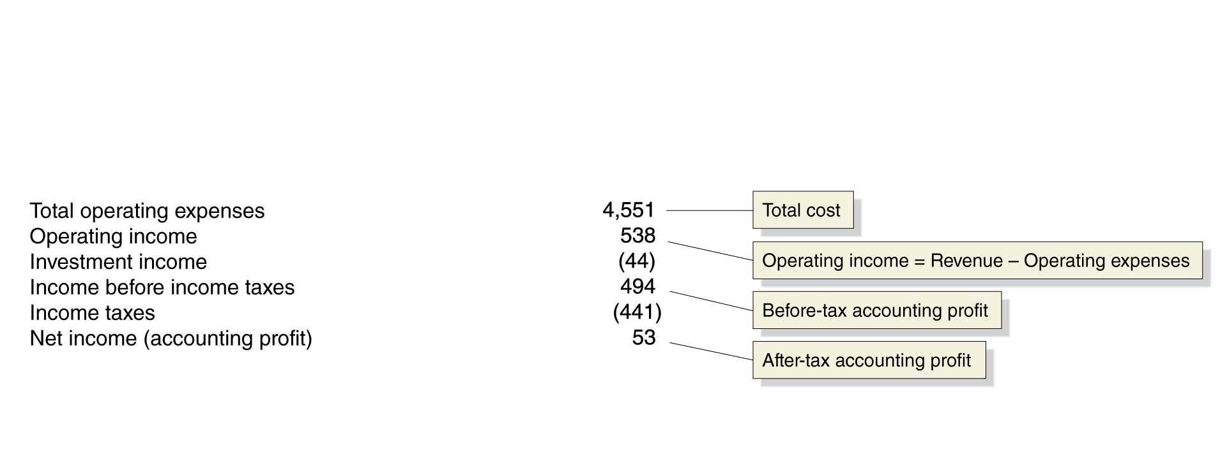

Analyzing income statements
Figure 8A.1
Facebook’s income statement for 2012
The difference between revenue ($5,089 million) and operating expenses ($4,551 million) is operating income ($538 million).
Most corporations also have investments, such as government or corporate bonds, that generate some income for them.
The sum of these incomes is the firm’s (before-tax) accounting profit.
Notes:
Facebook’s income statement shows the company’s revenue, costs, and
profit for 2012. The difference between its revenue ($5,089 million)
and its operating expenses ($4,551 million) is its operating income
($538 million). Most corporations also have interest expenses and income
from investments, such as government and corporate bonds. In
this case, Facebook paid $44 million more in interest expenses than it
earned on its investments, so its income before taxes was $494 million.
After paying taxes of $441 million, Facebook was left with a net income,
or accounting profit, of $53 million for the year.
Note: Negative values are shown in parentheses.
Source: Facebook 2012 10-K Annual Report. SEC EDGAR Web site
www.sec.gov/edgar.shtml.

Slide 46
Analyzing balance sheets
Assets |  | Liabilities and Stockholders' Equity
Current assets | $11,267 | Current liabilities | $1,052
Property and equipment | 2,391 | Long-term liabilities | 2,296
Goodwill | 1,388 | Total liabilities | 3,348
Other long-term assets | 57 | Stockholders’ equity | 11,755
Total assets | $15,103 | Total liabilities and stockholders' equity | $15,103
Note: All values are in millions of dollars.
Figure 8A.2
Facebook’s balance sheet as of December 31, 2012
Corporations list their assets on the left of their balance sheets and their liabilities on the right.
The difference between the value of the firm’s assets and the value of its liabilities equals the net worth of the firm, or stockholders’ equity.
Stockholders’ equity is listed by tradition as a liability, so the balance sheet must logically balance.
Notes:
Corporations list their assets on the left of
their balance sheets and their liabilities on
the right. The difference between the value
of a firm’s assets and the value of its liabilities
equals the net worth of the firm, or
stockholders’ equity. Stockholders’ equity is
listed on the right side of the balance sheet.
Therefore, the value of the left side of the
balance sheet must always equal the value of
the right side.
Source: Facebook 2012 10-K Annual Report.
SEC EDGAR Web site www.sec.gov/edgar.shtml.

